Slide 1


Refactoring:
Improving the Design of Existing Code
One of the best references on software refactoring, with illustrative examples in Java:
Refactoring: Improving the Design of Existing Code.
Martin Fowler. Addison Wesley, 2000. ISBN: 0201485672
See also www.refactoring.com Overview of this presentation
Refactoring basics
Categories of refactoring
2

Slide 2

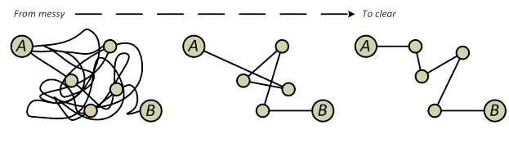
What is refactoring?
A refactoring is a software transformation that
preserves the external behaviour of the software;
improves the internal structure of the software.
It is a disciplined way to clean up code that minimises the chances of introducing bugs.

Slide 3

Definition of Refactoring [Fowler2000]
[noun] “a change made to the internal structure of software to make it easier to understand and cheaper to modify without changing its observable behaviour”
[verb] “to restructure software by applying a series of refactorings without changing its observable behaviour”
typically with the purpose of making the software easier to understand and modify

Slide 4
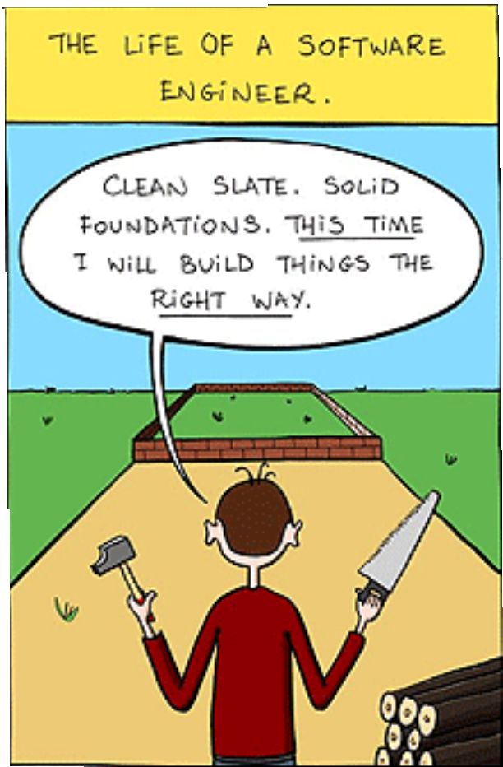
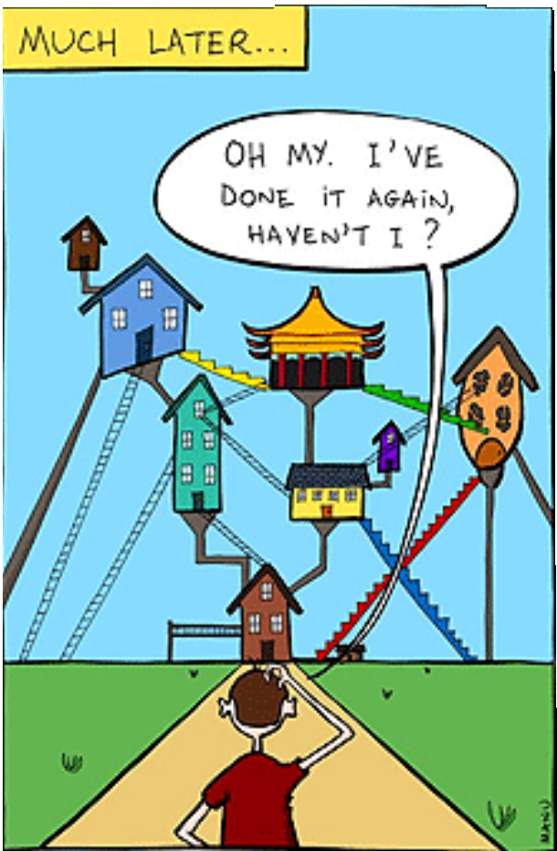
Why should you refactor?

Slide 5
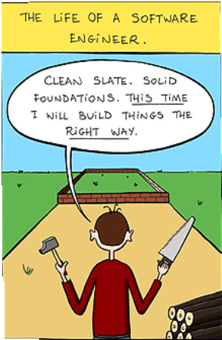
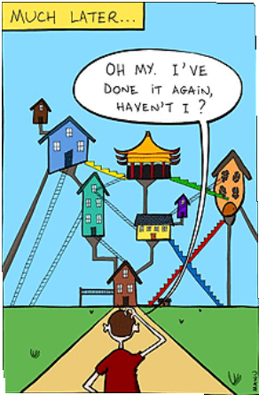
Why should you refactor?
To improve the design of software
To counter code decay (software ageing) refactoring helps code to remain in shape
To increase software comprehensibility to find bugs and write more robust code To increase productivity (program faster) on a long term basis, not on a short term basis

Slide 6
Why should you refactor?
To reduce costs of software maintenance
To reduce testing
automatic refactorings are guaranteed to be behaviour preserving
To prepare for / facilitate future customizations To turn an OO application into a framework
To introduce design patterns in a behaviourally preserving way

Slide 7

When should you refactor?
Whenever you see the need for it
Do it all the time in little bursts Not on a pre-set periodical basis
Apply the rule of three
1st time : implement from scratch
2nd time : implement something similar by code duplication 3rd time : do not implement similar things again, but refactor

Slide 8
When should you refactor?
Refactor when adding new features or functions
Especially if feature is difficult to integrate with the existing code
Refactor during bug fixing
If a bug is very hard to trace, refactor first to make the code more understandable, so that you can understand better where the bug is located
Refactor during code reviews

Slide 9
When should you refactor?
Refactoring also fits naturally in the agile methods
philosophy
Is needed to address the principle "Maintain simplicity"
Wherever possible, actively work to eliminate complexity from the system
By refactoring the code

Slide 10


What do you tell the manager?
When (s)he’s technically aware (s)he’ll understand why refactoring is important.
When (s)he’s interested in quality, (s)he’ll understand that refactoring will improve software quality.
When (s)he’s only interested in the schedule, don’t tell that you’re doing refactoring, just do it anyway.
In the end refactoring will make you more productive.

Slide 11
When shouldn’t you refactor?
When the existing code is such a mess that although you could refactor it, it would be easier to rewrite everything from scratch instead.
When you are too close to a deadline.
The productivity gain would appear after the deadline and thus be too late.
However, when you are not close to a deadline you should never
put off refactoring because you don’t have the time.
Not having enough time usually is a sign that refactoring is needed.

Slide 12
Categories of Refactoring

Slide 13
Categories of refactorings
Small refactorings
Big refactorings
Tease apart inheritance Extract hierarchy
Convert procedural design to objects Separate domain from presentation
(de)composing methods
moving features between objects organizing data
dealing with generalisation simplifying method calls

Slide 14


Small refactorings
(de)composing methods [7 refactorings]
moving features between objects [8 refactorings]
organizing data [16 refactorings]
dealing with generalisation [12 refactorings] simplifying method calls [15 refactorings]

Slide 15




Small Refactorings : (de)composing methods
Extract Method
Inline Method
Replace Temp With Query
Introduce Explaining Variable
Split Temporary Variable
Remove Assignments to Parameter
Substitute Algorithm
Legend:
= we will zoom in on these
= home reading

Slide 16



(De)composing methods:
1. Extract Method
What? When you have a fragment of code that can be grouped together, turn it into a method with a name that explains the purpose of the method
Why? improves clarity, removes redundancy
Example:
public void accept(Packet p) {
if ((p.getAddressee() == this) && (this.isASCII(p.getContents())))
this.print(p); else
super.accept(p); }
public void accept(Packet p) {
if this.isDestFor(p) this.print(p); else super.accept(p); }
public boolean isDestFor(Packet p) { return
((p.getAddressee() == this) && (this.isASCII(p.getContents()))); }
Beware of local variables !

Slide 17


(De)composing methods :
2. Inline Method
(Opposite of Extract Method)
What? When a method’s body is just as clear as its name, put the method’s body into the body of its caller and remove the method
Why? To remove too much indirection and delegation
Example:
int getRating(){
return moreThanFiveLateDeliveries();
}
boolean moreThanFiveLateDeliveries(){ return _numberOfLateDeliveries > 5;
}
int getRating(){
return (_numberOfLateDeliveries > 5);
}

Slide 18

(De)composing methods :
3. Replace Temp with Query
What? When you use a temporary variable to hold the result of an expression, extract the expression into a method and replace all references to the temp with a method call
Why? Cleaner code
Example:
double basePrice = _quantity * _itemPrice; if (basePrice > 1000)
return basePrice * 0.95;
else
return basePrice * 0.98;
if (basePrice() > 1000)
return basePrice() * 0.95;
else
return basePrice() * 0.98;
…
double basePrice(){
return _quantity * _itemPrice;
}

Slide 19
(De)composing methods :
4. Introduce Explaining Variable
What? When you have a complex expression, put the result of the (parts of the) expression in a temporary variable with a name that explains the purpose
Why? Breaking down complex expressions for clarity
Example:
if ( (platform.toUpperCase().indexOf(“MAC”) > -1) && (browser.toUpperCase().indexOf(“IE”) > -1) && wasInitialized() && resize > 0 )
{
//ACTION
}
final boolean isMacOs = platform.toUpperCase().indexOf(“MAC”) > -1; final boolean isIEBrowser = browser.toUpperCase().indexOf(“IE”) > -1; final boolean wasResized = resize > 0;
if (isMacOs && isIEBrowser && wasInitialized() && wasResized){
//ACTION
}

Slide 20

(De)composing methods :
5. Split Temporary Variable
What? When you assign a temporary variable more than once, but it is not a loop variable nor a collecting temporary variable, make a separate temporary variable for each assignment
Why? Using temps more than once is confusing
Example:
double temp = 2 * (_height + _width); System.out.println (temp);
temp = _height * _width; System.out.println (temp);
final double perimeter =
2 * (_height + _width); System.out.println (perimeter);
final double area = _height * _width; System.out.println (area);

Slide 21
(De)composing methods :
6. Remove Assignments To Parameter
What? When the code assigns to a parameter, use a temporary variable instead
Why? Lack of clarity and confusion between “pass by value”
and “pass by reference”
Example:
int discount (int inputVal, int quantity, int yearToDate){
if (inputVal > 50) inputVal -= 2;
... MORE CODE HERE ...
int discount (int inputVal, int quantity, int yearToDate){
int result = inputVal;
if (inputVal > 50) result -= 2;
... MORE CODE HERE ...

Slide 22


(De)composing methods :
7. Substitute Algorithm
What? When you want to replace an algorithm with a clearer alternative, replace the body of the method with the new algorithm
Why? To replace complicated algorithms with clearer ones
Example:
String foundPerson(String[] people){
for (int i = 0; i < people.length; i++){ if (people[i]. equals (“John”) ) {
return “John”;
}
if (people[i]. equals (“Jack”) ) {
return “Jack”;
}
}
}
String foundPerson(String[] people){
List candidates = Array.asList(new String[] {“John”, “Jack”, Tauseef”})
for (int i = 0; i < people.length; i++)
if (candidates[i]. contains (people[i])) return people[i];
}

Slide 23
Small refactorings
(de)composing methods [9 refactorings]
moving features between objects [8 refactorings]
organizing data [16 refactorings]
dealing with generalisation [12 refactorings] simplifying method calls [15 refactorings]

Slide 24


Small Refactorings : moving features between objects
Move Method
Move Field
Extract Class
Inline Class
Hide Delegate
Remove Middle Man
Legend:
= we will zoom in on these
= home reading

Slide 25
Moving features between objects : 1,2. Move Method / Field
What? When a method (resp. field) is used by or uses more features of another class than its own, create a similar method (resp. field)
in the other class; remove or delegate original method (resp. field) and redirect all references to it.
Why? Essence of refactoring
Example:
Class 1
Class 1
Clas
s 2
Clas
s 2
aMethod()
aMethod()

Slide 26

Moving features between objects :
3. Extract Class
What? When you have a class doing work that should be done by two, create a new class and move the relevant fields and methods to the new class
Why? Large classes are hard to understand
Example:
Person
Person
PhoneNumber
areaCode number
getPhoneNumber
name officeAreaCode officeNumber homeAreaCode homeNumber
name
1
phone
getOfficePhone getHomePhone
getOfficePhone getHomPhone

Slide 27

Moving features between objects :
4. Inline Class
What? When you have a class that does not do very much, move all its features into another class and delete it
Why? To remove useless classes (as a result of other refactorings)
Example:
Person
PhoneNumber
Person
name
office- phone
areaCode
number getPhoneNumber()
name
officeAreaCode
officeNumber getPhoneNumber()
1
1
getPhoneNumber()

Slide 28

Moving features between objects :
5. Hide Delegate
What? When you have a client calling a delegate class of an object, create methods on the server to hide the delegate
Why? Increase encapsulation
Example:
Client Class
Client Class
Person
Department
Person
Department
getDepartment()
getManager()
getManager()
getManager()

Slide 29
Moving features between objects :
6. Remove Middle Man
What? When a class is doing too much simple delegation, get the client to call the delegate directly
Why?
To remove too much indirection (as a result of other refactorings)
Example:
Person
Client Class
Client Class
getManager()
Person
Department
Department
getDepartment()
getManager()

Slide 30
Small refactorings
(de)composing methods [9 refactorings]
moving features between objects [8 refactorings]
organizing data [16 refactorings]
simplifying conditional expressions [8 refactorings]
dealing with generalisation [12 refactorings] simplifying method calls [15 refactorings]

Slide 31

Small Refactorings : organizing data
Encapsulate field
Replace data value with object
Change value to reference
Change reference to value
Replace array with object
Duplicate observed data
Change unidirectional association to bidirectional
Change bidirectional association to unidirectional
Replace magic number with symbolic constant
Encapsulate collection
Replace record with data class
Replace subclass with fields
13-16. Replace type code with class / subclass / state / strategy

Slide 32


Organizing Data :
1. Encapsulate Field
What? There is a public field. Make it private and provide accessors.
Why?
Encapsulating state increases modularity, and facilitates code reuse and maintenance.
When the state of an object is represented as a collection of private variables, the internal representation can be changed without modifying the external interface
Example:
private String name; public String getName() {
return this.name; }
public void setName(String s) { this.name = s; }
public String name;

Slide 33
Organizing Data :
12. Replace Subclass with Fields
What? Subclasses vary only in methods that return constant data
Solution: Change methods to superclass fields and eliminate subclasses
Example:
Person
Person
sex: [M, F]
Male
Female
Similar to replace inheritance with aggregation

Slide 34
Organizing Data :
13. Replace Type Code with Subclass
What? An immutable type code affects the behaviour of a class
Example:
Employee const Engineer=0 const Salesman=1 const Manager=2 type:Int
Employee
Engineer
Salesman
Manager

Slide 35

Organizing Data :
15,16. Replace Type Code with State/Strategy
When? If subclassing cannot be used, e.g. because of dynamic
type changes during object lifetime (e.g. promotion of employees)
Example:
Employee
EmployeeType
Employee
const Engineer=0 const Salesman=1 const Manager=2 type:Int
Engineer
Salesman
Manager
Makes use of state pattern or strategy design pattern

Slide 36
Small refactorings
(de)composing methods [9 refactorings]
moving features between objects [8 refactorings] organizing data [16 refactorings]
dealing with generalisation [12 refactorings]
simplifying method calls [15 refactorings]

Slide 37


Small Refactorings : dealing with generalisation
Push down method / field
Pull up method / field / constructor body
Extract subclass / superclass / interface
Collapse hierarchy
Form template method
Replace inheritance with delegation (and vice versa)

Slide 38
Dealing with Generalisation:
1. Push Down Method
When behaviour on a superclass is relevant only for some of its subclasses, move it to those subclasses
Employee
Employee
getQuota
Salesman
Engineer
Salesman
Engineer
getQuota

Slide 39

Dealing with Generalisation:
2. Pull Up Method
Simple variant: look for methods with same name in subclasses that do not appear in superclass
More complex variant: do not look at the name but at the behaviour of the method
If the method that is being pulled up already exists in the superclass as an abstract method, make it concrete with the common behaviour
Printserver
Printserver
accept
ASCIIPrinter
PSPrinter
accept
accept
ASCIIPrinter
PSPrinter

Slide 40

Dealing with Generalisation:
3. Extract Superclass
When you have 2 classes with similar features
Outputserver
PrintServer
FileServer
Printserver
Fileserver

Slide 41
Small refactorings
(de)composing methods [9 refactorings]
moving features between objects [8 refactorings] organizing data [16 refactorings]
simplifying conditional expressions [8 refactorings] dealing with generalisation [12 refactorings]
simplifying method calls [15 refactorings]

Slide 42

Small Refactorings : simplifying method calls
Rename method
Add parameter
Remove parameter
Separate query from modifier
Parameterize method
Replace parameter with method
Replace parameter with explicit methods
Preserve whole object
Introduce parameter object
Remove setting method
Hide method
Replace constructor with factory method
Encapsulate downcast
Replace error code with exception
Replace exception with test

Slide 43

Simplifying method calls:
14. Replace Error Code with Exception
What? When a method returns a special code to indicate an error, throw an exception instead
Why? Clearly separate normal processing from error processing
Example:
int withdraw(int amount) { if (amount > balance)
return -1
else
{balance -= amount; return 0}
}
void withdraw(int amount) throws BalanceException { if (amount > balance) throw new BalanceException(); balance -= amount;
}

